Slide 1

2022 Yearly Update

Slide 2


New Streaming Platforms
We’re excited to welcome Trovo and Glimesh to the Mix It Up!
Users can now access both streaming platforms in the Public version of Mix It Up

Slide 3

YouTube Live Test Now Available!
After several months of the quota approval processes, we’ve finally ready to start testing YouTube Live support!
Due to the nature of YouTube’s quota system, we’ll be starting with a limited test build first. Interested users can apply by visiting:
https://www.mixitupapp.com/youtubetest

Slide 4
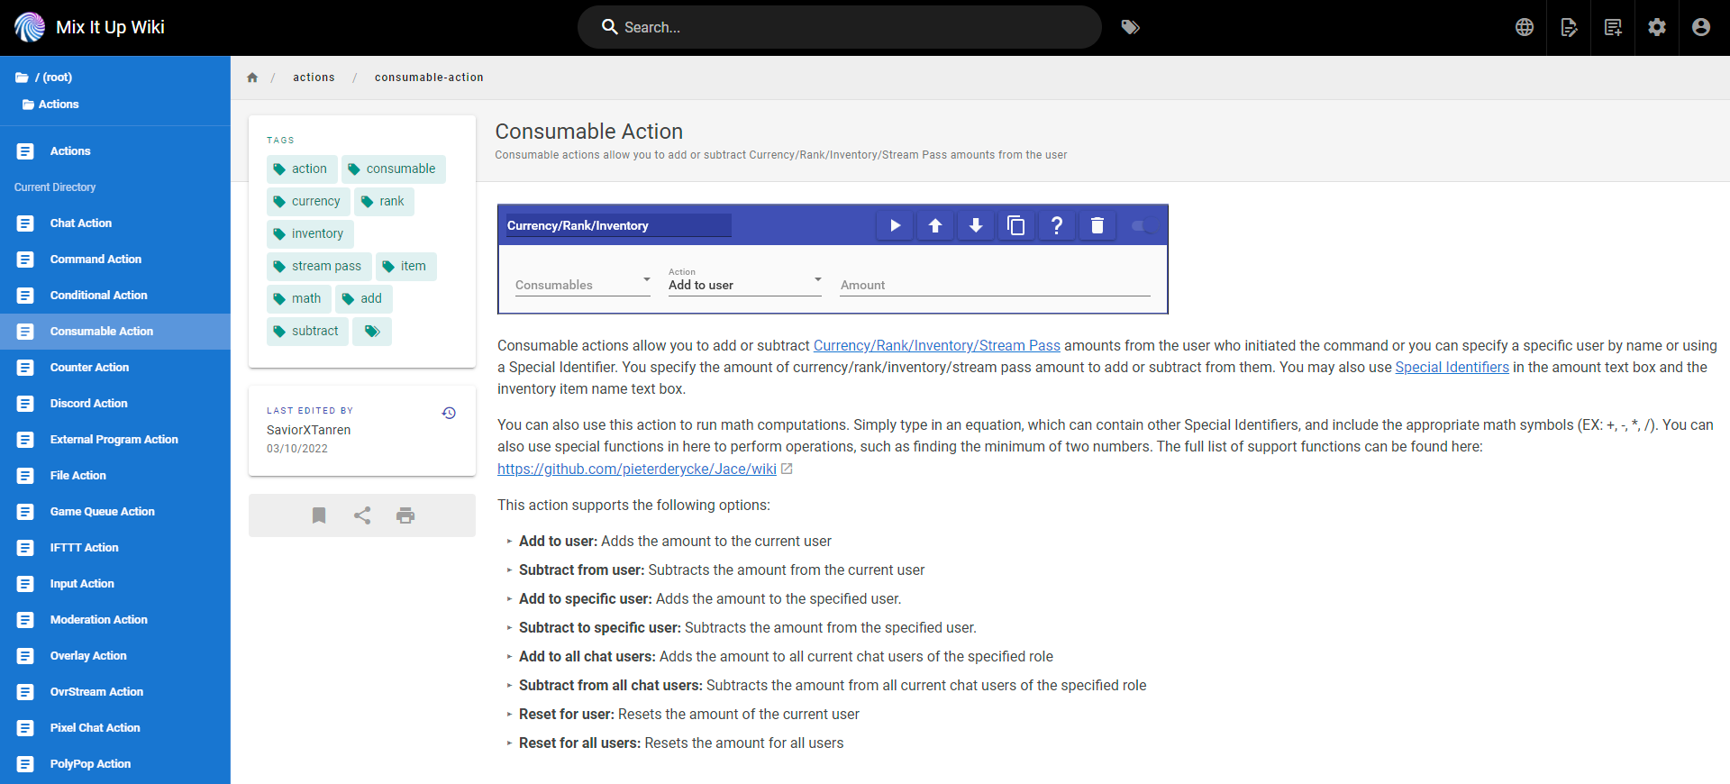
New Mix It Up Wiki
https://www.mixitupapp.com/wiki

Slide 5
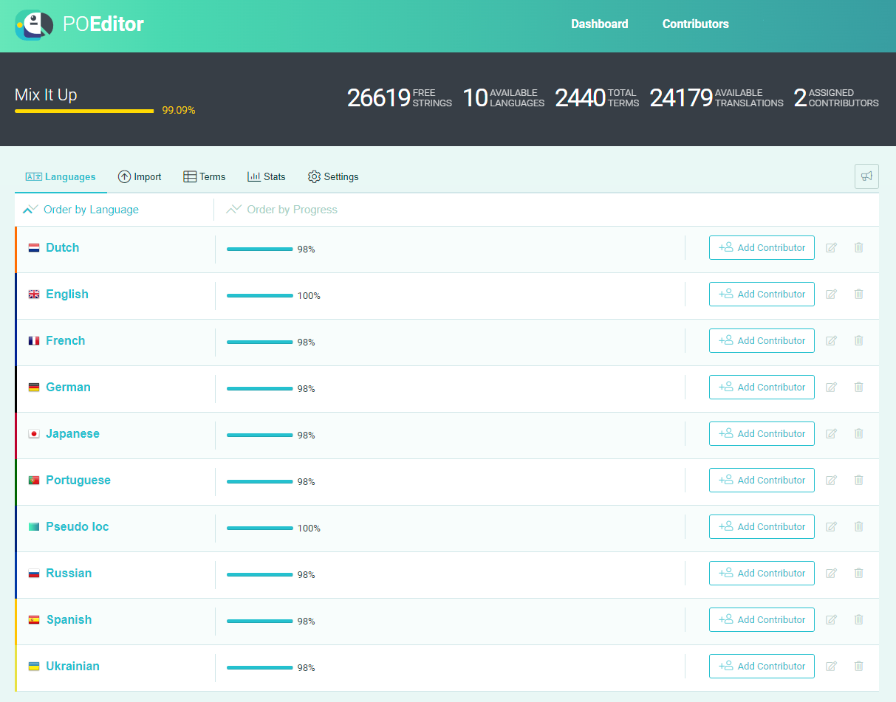
New Public Localization Support
https://www.mixitupapp.com/localization

Slide 6

The Ambassador Program is a new partnership opportunity to support our community members. We help provide the tools and resources to you to help you create awesome Mix It Up content for your viewers, plus you get some nice perks for yourself.
Apply Today: https://mixitupapp.com/ambassador

Slide 7

Mix It Up will be at TwitchCon 2022 in San Diego!
Mix It Up will have it’s first convention booth in the Streamer Workshop. We’ll have demo stations to let users try out Mix It Up, a full live-stream from the show floor, giveaways, & more!
Be sure to stop by!

Slide 8
User Donations
Mix It Up is a free, open-source application.
There’s no fee or subscription to use the app, as it doesn’t “cost” us anything to run it beyond minor expenses.
We’re often asked by our users how they can financially give back to the team for the work we do.
While we appreciate it, we like to ensure that even when giving something, you’re getting something in return for your money.

Slide 9

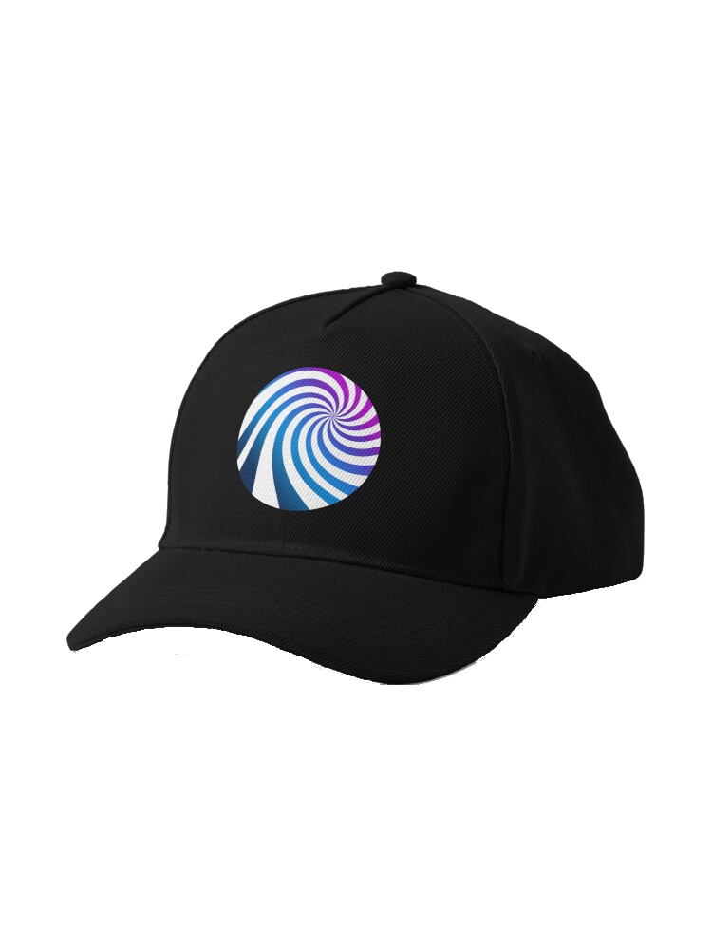

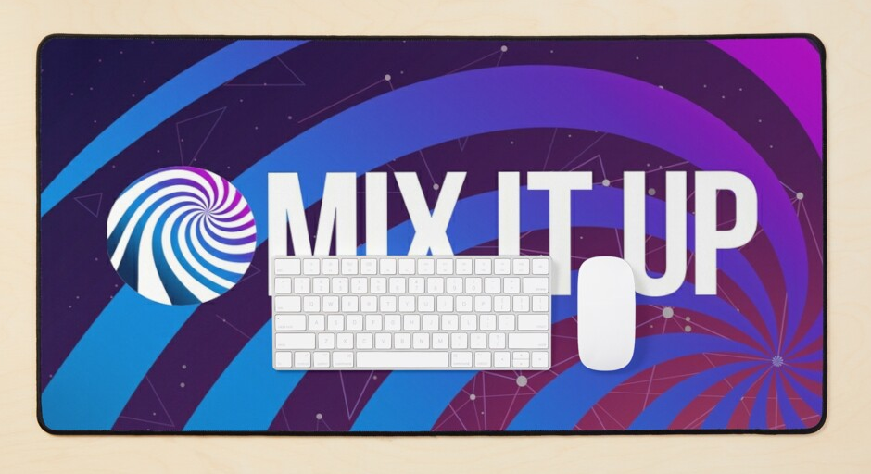

https://mixitupapp.com/redbubble

Slide 10


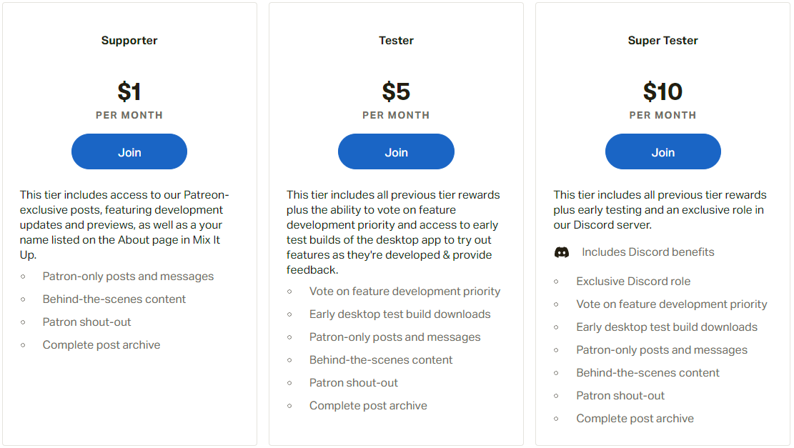
https://mixitupapp.com/patreon

Slide 11



Mix It Up through the years…
Nov 2017
First Version
Mixer-exclusive
June 2020
Mixer Closure
Twitch Migration
March 2022
Multi-Platform
Trovo & Glimesh

Slide 12
5 years of powering your streams
2022 marks the 5-year anniversary from when Mix It Up first started
6,500 Daily Active Users
21,000 Monthly Active Users
400,000 Monthly Service Connection
5,000,000 Monthly Commands Run
We’re ecstatic with the support & love we get from our community and we’re ready to take it to the next level…

Slide 13




Slide 14
“Same Mix It Up Flavor,
Same Mix It Up Taste”
Mix It Up Desktop will continue to be our desktop solution to your streaming needs
Free always and forever, we have no plans on stopping work on new features and options

Slide 15
Mix It Up Online will be the fully-online, web-hosted bot version of what you know & love
All the same features plus new and exciting ones only possible via online
Planned Alpha & Beta testing opportunities for the community

Slide 16
Planned Online Features
Fully Moderator & Channel Editor connectivity and permissions
Support for Windows, Mac, Linux, iOS, Android
Lightweight desktop app to continue connecting all your desktop applications (OBS Studio, Voicemod, VTube Studio, and more)
Advanced channel analytics, social media management, etc.
And even more…

Slide 17
Desktop vs Online
Mix It Up Desktop has always been free for several reasons, mainly because there are no major reoccurring costs; all minor costs we simply cover out-of-pocket
Building a fully-online version of Mix It Up will however have large costs associated with it to run your commands, store data, and ensure fast & performant functionality
Money earned via Patreon & RedBubble will help to offset some development costs with the rest being covered out-of-pocket by the Mix It Up development team
Because of this and the fact that we’ll be continuing to maintain Mix It Up Desktop for free, we are investigating some form of a payment system for use of Mix It Up Online to ensure we can cover costs
No specifics have been determined, but we do have the following goals:
Simple & straight-forward pricing, no tiering of individual features
Features worth your money spent and only when costs dictate them
30-day, no risk, free trial to ensure it meets all your needs

Slide 18
Q&A Time!

